Slide 1

AIR POLLUTION
Presented By: Sasanapuri Manoj
PIN:23551AO5D5
Supervisor: Mr.D.Phani Kumar
Designation: ,
Dept. of CSE, GIET(A)

Slide 2
Contents
Introduction
Causes of Air Pollution?
Effects on Air Pollution
Impact on Daily Life
How to Reduce Air Pollution?

Slide 3
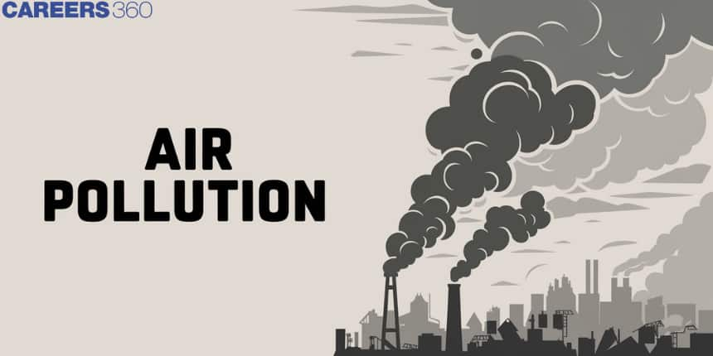
Introduction
Air pollution = harmful substances in the air we breathe.
Affects health, environment, and daily life.
Caused by humans and nature.
-

Slide 4
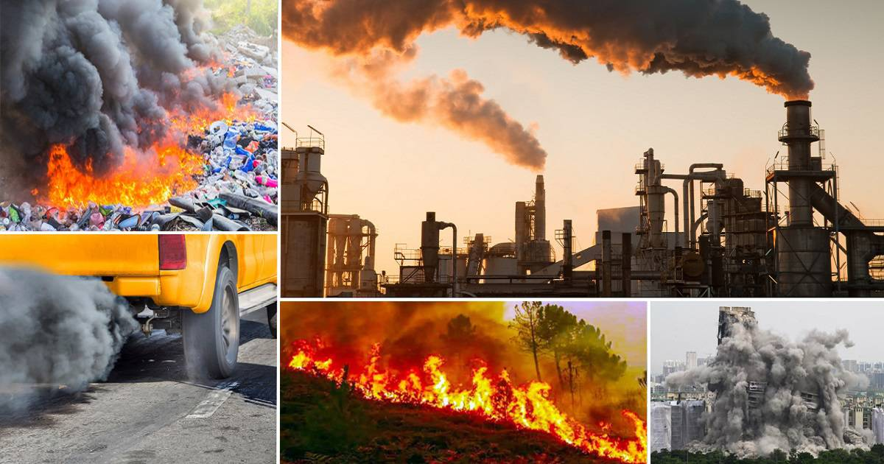
Causes of Air Pollution
Human-made:
Vehicle emissions (cars, trucks).
Factory smoke and industrial waste.
Burning of fossil fuels (coal, oil, wood)
Waste burning.
Natural Causes:
Dust storms.
Volcanic eruptions.
Wildfires.

Slide 5
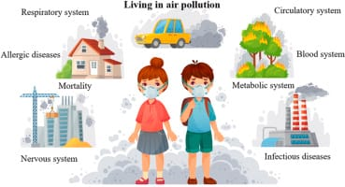
Effects on Air Pollution
Effects on Human Health:
Breathing problems (asthma, cough).
Heart and lung diseases.
Eye irritation and allergies.
Weak immune system.

Slide 6
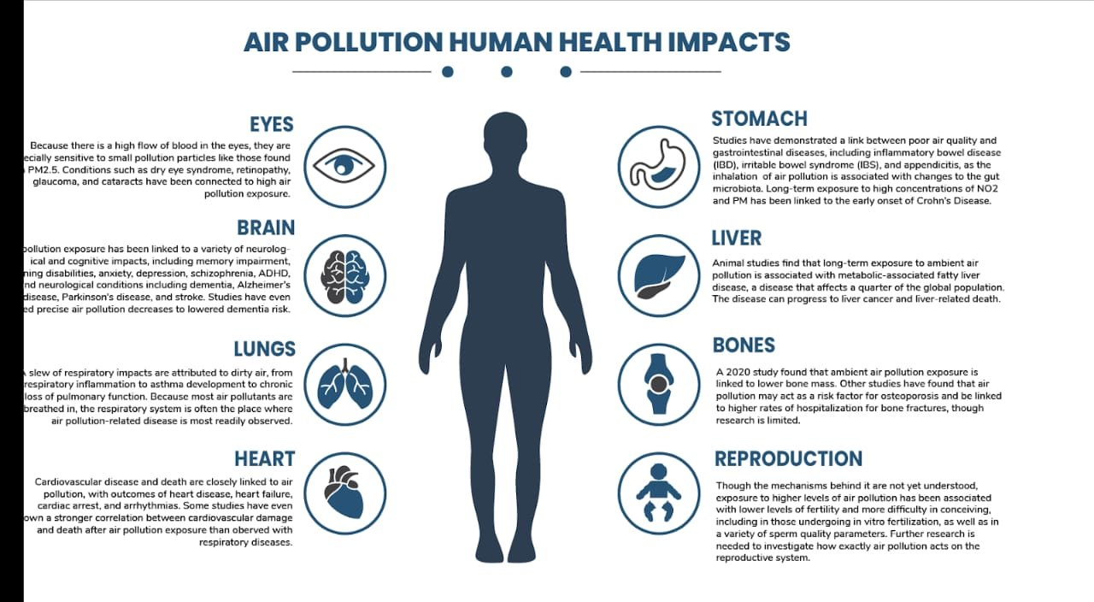
Impact on Daily Life
Poor visibility
Increased health costs
Reduced outdoor activities
Disruption of daily routines

Slide 7
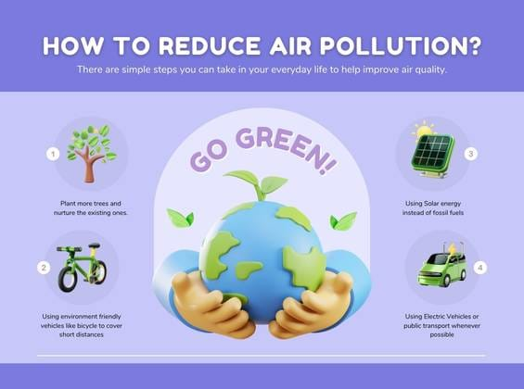
How to Reduce Air Pollution
Use public transport or cycle
Plant more trees
Reduce industrial emissions
Avoid burning garbage
Use eco-friendly fuels

Slide 8
Thank You

